Slide 1


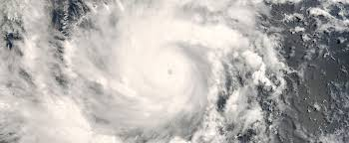
TensorFlood

Slide 2
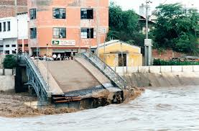
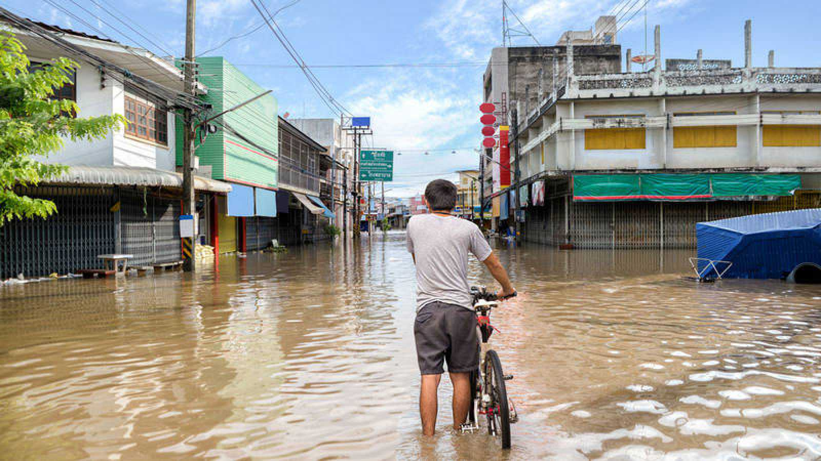
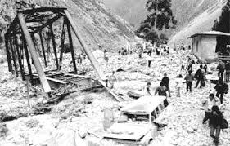
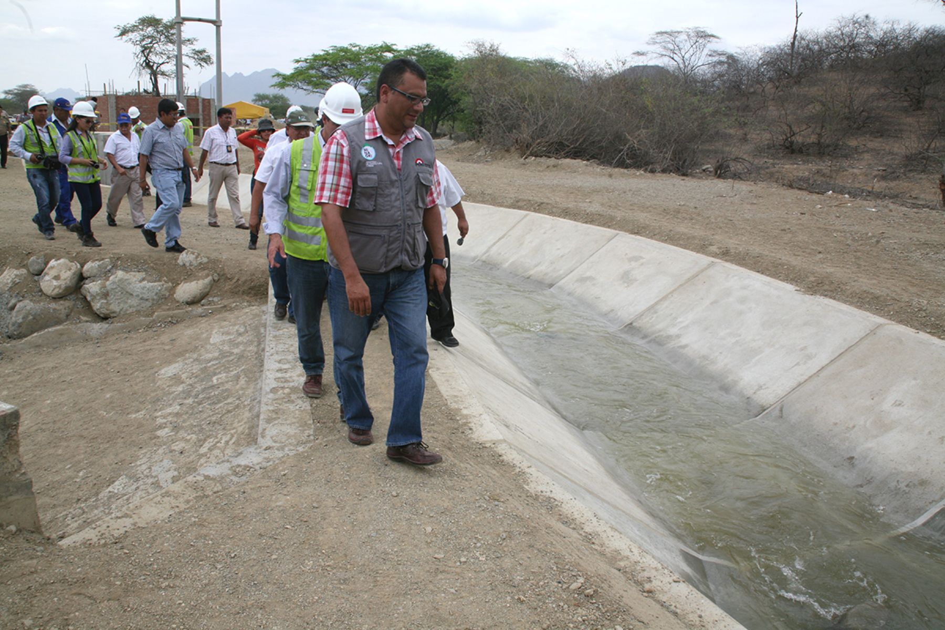
Problematic
The phenomenon of 'El niño' affects the Peruvian families of the coast of the country. It happens every so often and the consequences are serious.
The government have some kind of solutions but It is not implement properly. They try to invest in the roads and reserve water for affected families. But It isn’t sufficient.

Slide 3
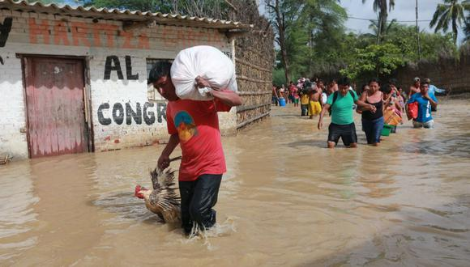
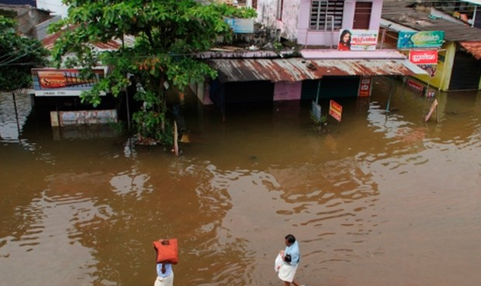
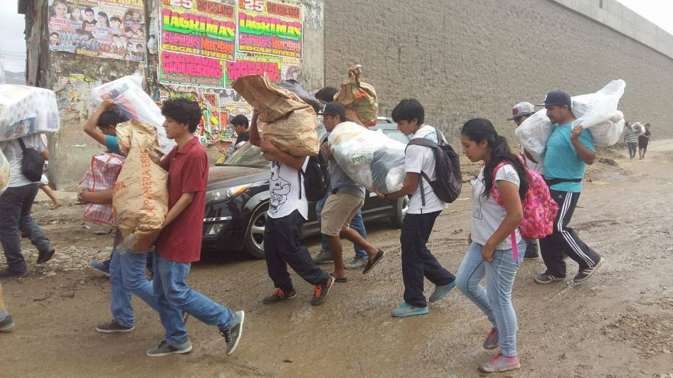
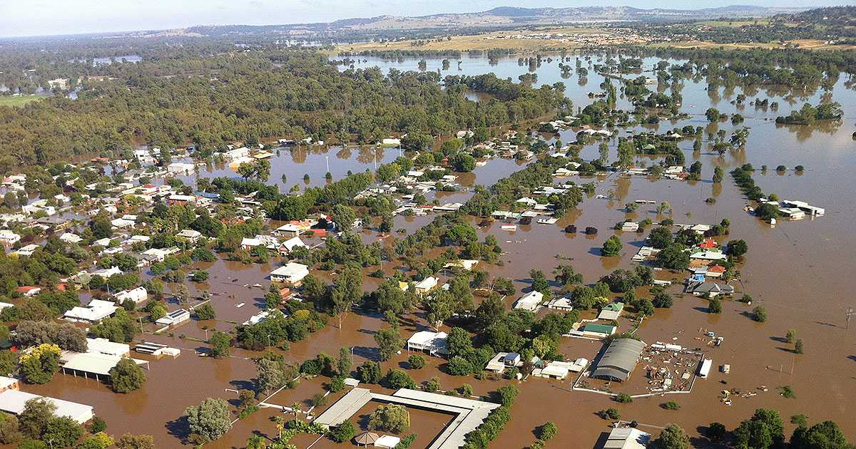

Slide 4







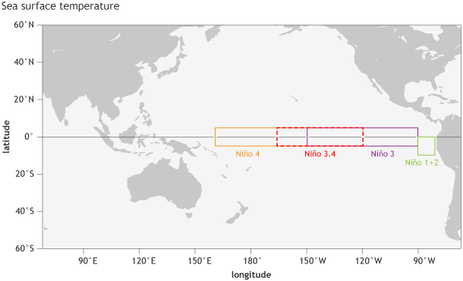
Solution
Gathering data
Temperature
Wind velocity and direction
Precipitation in mm
Humidity
Oceanic Nino Index (ONI)

Slide 5
How does the app work
https://tensorflood.invisionapp.com/prototype/ckfvf4vai000thv0105goly1m/play

Slide 6

Financing
Government
Non Governmental Organization
PRODUCE
Programme:
“Innóvate Perú” - “Reto Perú Resiliente”
Crowdfunding
With river data sources the app will work better, but we need financiation for this.
CESAL - Entreculturas - Codespa - Intered
Emprende UP - Social impact
Notes:
PRODUCE (Ministerio de la Producción)
“Innóvate Perú” - “Reto Perú Resiliente” (Innovaciones para la gestión de riesgo de desastres, se cofinancia proyectos de innovación)
With river data sources the app will work better, but we need financing for this.

Slide 7


Coming Soon
With this App, we will keep your family informed by monitoring the state you are in, during and after weather ‘El Nino’. With which, we will improve communication for the entire community, so with this information we will can know the victims who need help.

